Slide 1

Addressing Phase Noise Issues in FMCW Lidar
Taehwan Kim

Slide 2


FMCW lidar
No tradeoff between peak power vs. resolution like pulsed lidar
Requires longer integration for resolving smaller frequency difference
No need for fast electrical FE
Coherent RX achieves shot-noise limited detection with normal PD
Interference rejection
What are the issues when you try to extend the range, say 100m?
FMCW LIDAR
Tunable Laser
Splitter
Target
LO Path
Beat
Signal
Coupler
Spectrometer

Slide 3
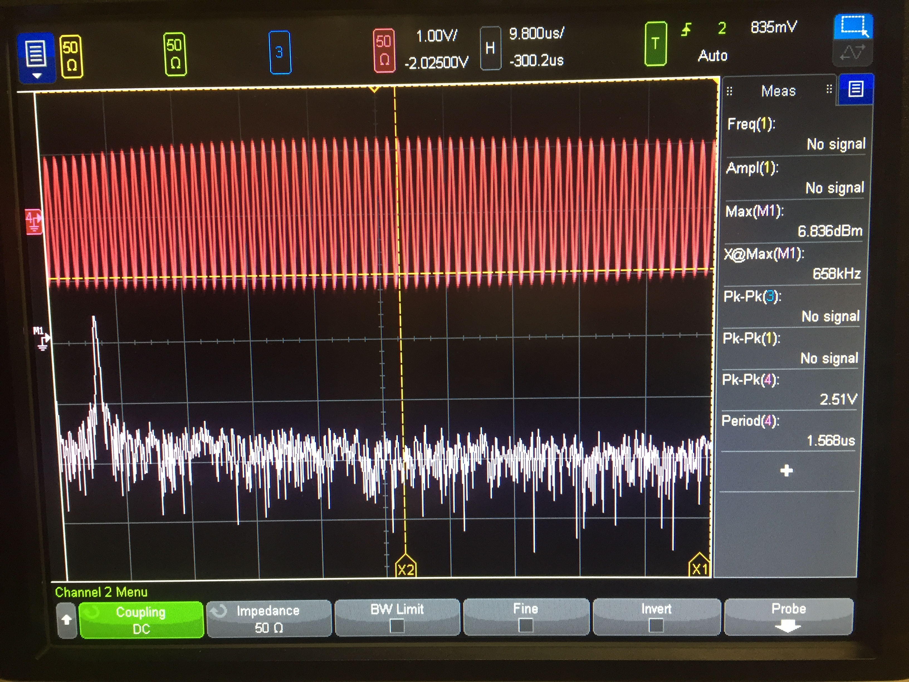
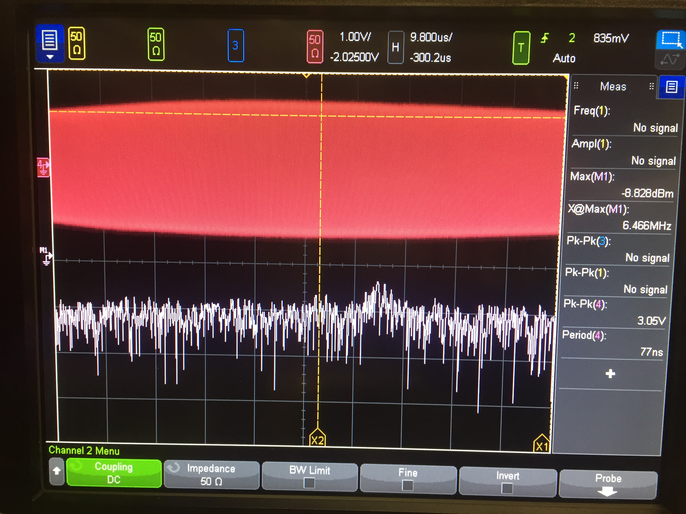
Phase Noise Problem
FMCW LIDAR
Tunable Laser
Splitter
Target
LO Path
20cm
2m
The farther the target is away, the less the phase noise of TX/RX beams are correlated (less coherent)
Even though you have infinite laser power, SNR is limited by the spectral purity of the tunable laser
Beat
Signal
Coupler
Spectrometer

Slide 4
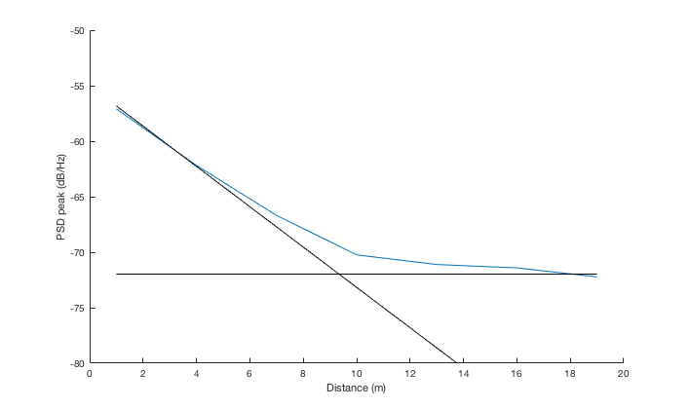
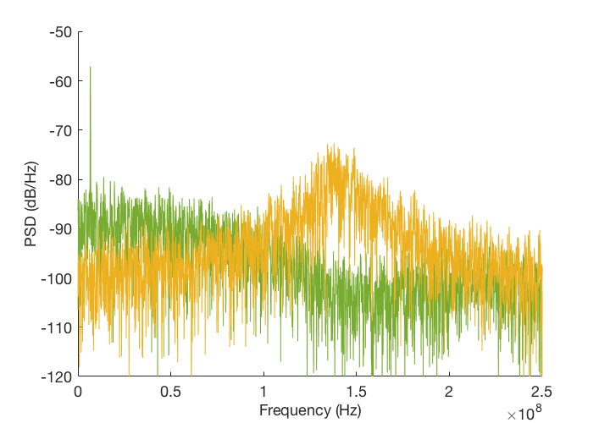
Phase Noise Problem
Photocurrent PSD from theory
Beyond coherence range (𝜏 > 𝜏_{c}), beating signal vanishes; it’s just Lorentzian lineshape + shot noise floor
This is the case for both colored/white frequency noise in the laser
Linewidth: 10MHz
Coherence range: 4.77m
Scan time: 10us
Coherence range
Phase noise pedestal peak
Signal power
1m
20m

Slide 5
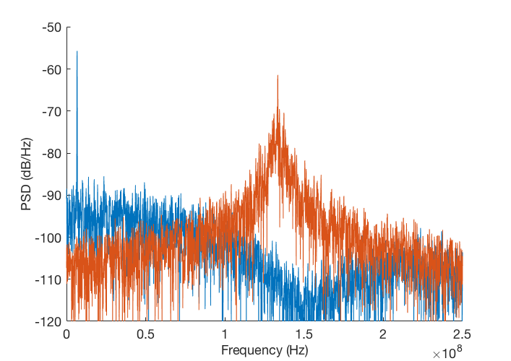
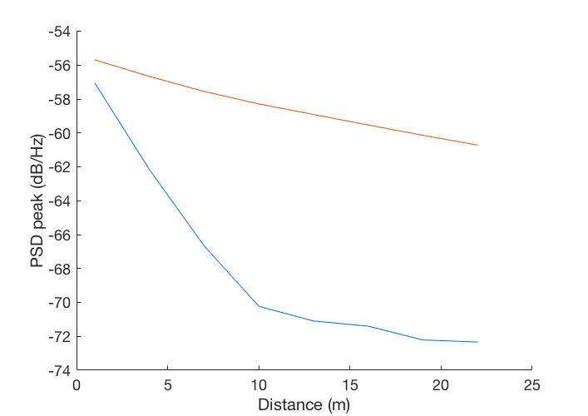
Photocurrent PSD Beyond Coherence Range
Scan time: 10us
1m
Linewidth: 2MHz²/Hz
20m
Linewidth: 10MHz²/Hz
1m
20m

Slide 6
Photocurrent PSD Beyond Coherence Range
Scan time: 10us
1m
Linewidth: 2MHz²/Hz
20m
How can we solve phase noise problem?
By using better spectral estimation algorithm
By improving laser modulation hardware
Linewidth: 10MHz²/Hz
1m
20m

Slide 7
Photocurrent PSD Beyond Coherence Range
Scan time: 10us
1m
Linewidth: 2MHz²/Hz
20m
How can we solve phase noise problem?
By using better spectral estimation algorithm
By improving laser modulation hardware
Linewidth: 10MHz²/Hz
1m
20m

Slide 8
Detection Algorithm
Common belief: targets should always be within the coherence range
Significantly constrains linewidth spec for tunable laser
Long-range Lidar is not targeting for 𝜇m-level accuracy
If we can assume there’s single scatterer, we can fit the PSD estimate to the known shape (Lorentzian + white background) to get better distance estimate than just FFT → peak-finding
Problem of super-resolution!
Given prior:

Slide 9
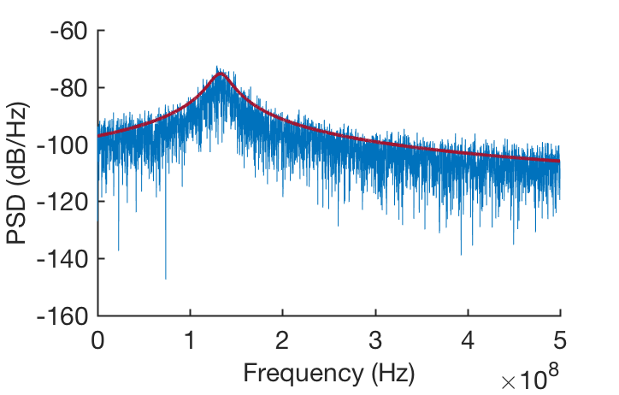
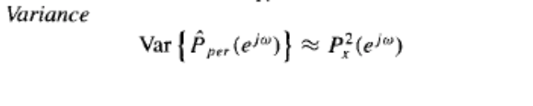
Spectral Estimation Process
Procedure
Estimate PSD from time-domain signal with FFT (periodogram)
Then apply fitting with known Lorentzian prior
Fitting methods
(Nonlinear) least squares estimation (LSE)
Maximum likelihood estimation (MLE)
MLE can be better, as it can take into account the uneven estimation variance of periodogram over frequency bins
For periodogram estimation, variance is bigger for bins with higher power
(just like shot-noise limited photodetectors)

Slide 10
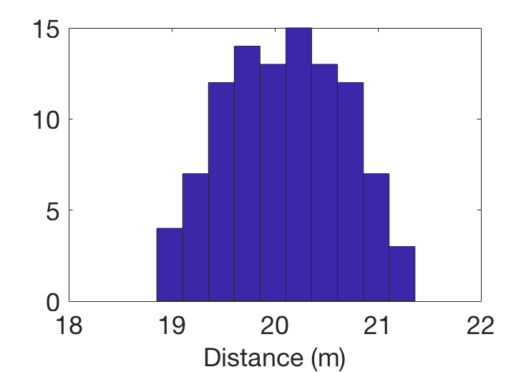
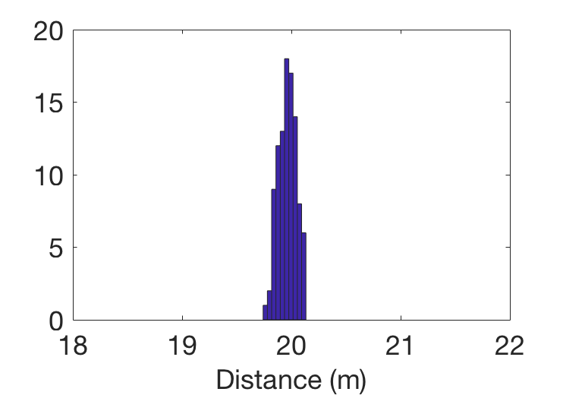
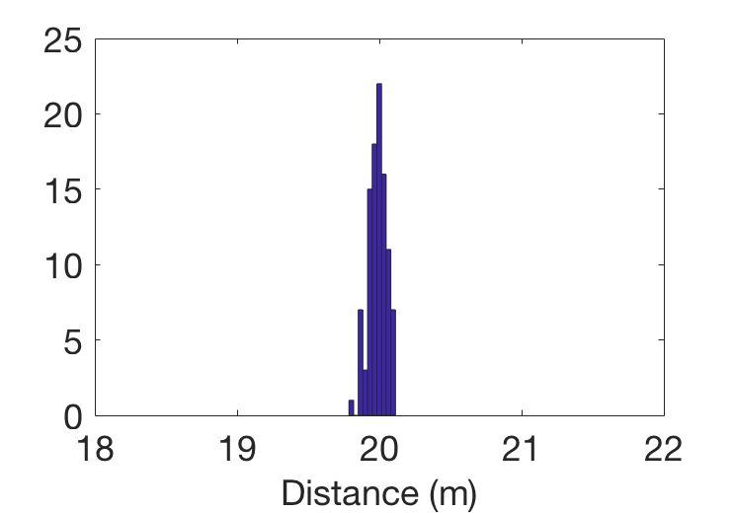
Example
Distance: 20m
Linewidth: 10MHz²/Hz
Chirp bandwidth: 10GHz
Scan time: 10us
Bin-size limited resolution: 1.5cm
100 samples
Zero shot noise
Periodogram + peak-finding
𝜎=58.7cm
LSE
MLE
𝜎=8.2cm
𝜎=6.4cm

Slide 11
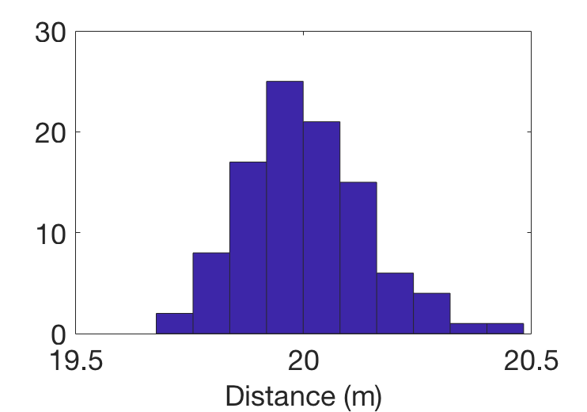
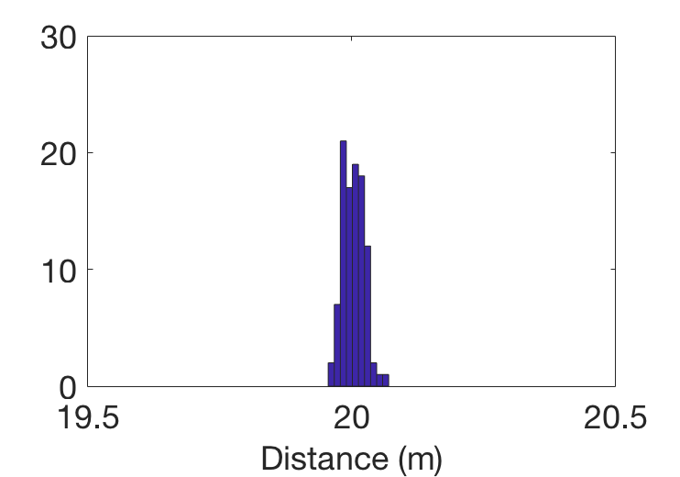
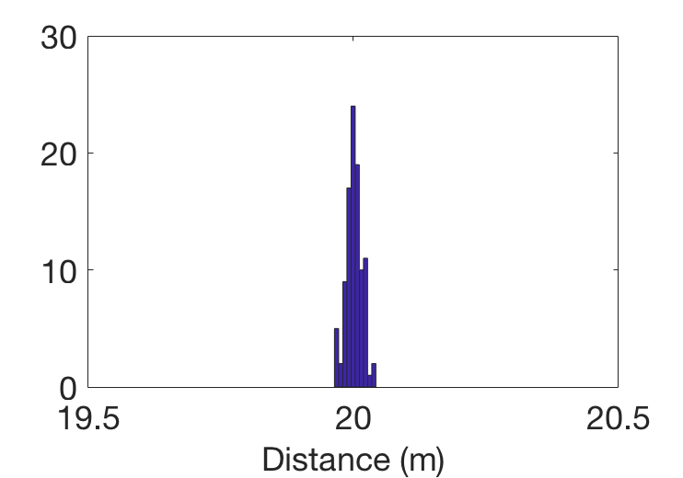
Example
Distance: 20m
Linewidth: 10MHz²/Hz
Chirp bandwidth: 40GHz
Scan time: 10us
Bin-size limited resolution: 0.375cm
100 samples
Zero shot noise
Periodogram + peak-finding
𝜎=13.8cm
LSE
MLE
𝜎=2.03cm
𝜎=1.5cm

Slide 12
End-to-End Model for System Design Guideline
Plugging everything into the end-to-end model, what is the required RX power to achieve desired accuracy (say 10cm)?
Required LO power is determined by the electrical frontend design → need to increase just until the photodetector is shot-noise limited
The performance is no longer sensitive to the distance once it’s in incoherent regime
FMCW LIDAR
Tunable Laser
Splitter
Target
LO Path
Beat
Signal
Coupler
Spectrometer
How much power we need here to hit certain accuracy target?

Slide 13
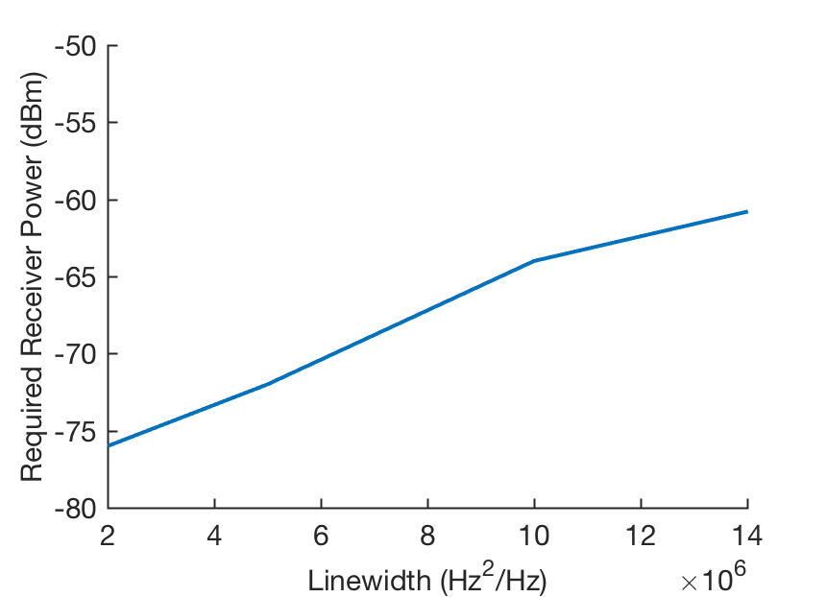
End-to-End Model for System Design Guideline
Takeaway
Actual spectral estimation algorithm has to be included in the system-level specification
For given linewidth, there’s a lower bound for the required RX beam power (so that the Lorentzian is not completely buried by the shot noise floor)
Beyond that lower bound and for target accuracy, required power is inversely proportional to the chirp bandwidth
Chirp bandwidth: 10GHz
Scan time: 10us
R_{PD}: 1A/W
MLE fitting

Slide 14
Photocurrent PSD Beyond Coherence Range
Scan time: 10us
1m
Linewidth: 2MHz²/Hz
20m
How can we solve phase noise problem?
By using better spectral estimation algorithm
By improving laser modulation hardware
Linewidth: 10MHz²/Hz
1m
20m

Slide 15
Feedforward Phase Noise Cancellation
Optical PLL for laser chirp linearization
Can solve chirp nonlinearity problem, but phase noise filtering is limited by the closed-loop bandwidth of the PLL

Slide 16
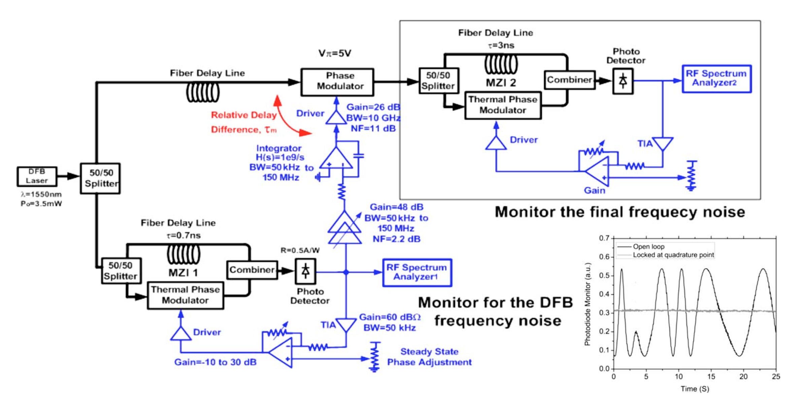
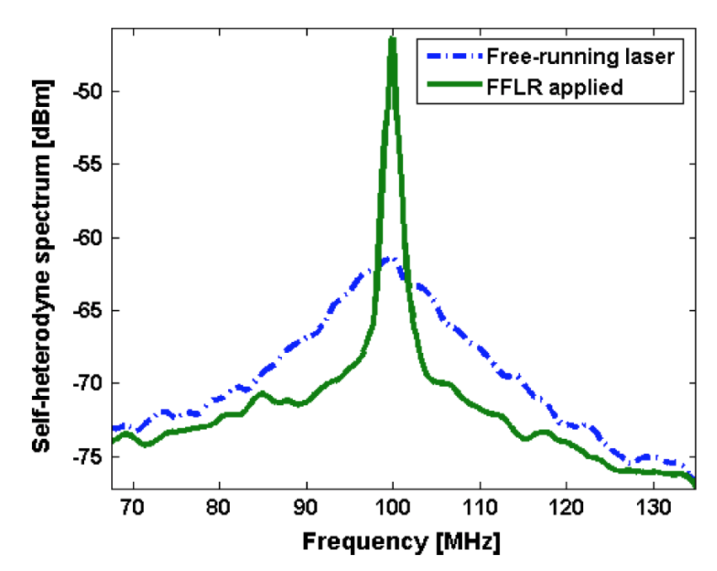
Feedforward Phase Noise Cancellation
Laser phase noise reduction with feedforward cancellation
Use asymmetric MZI to measure the phase noise & actively cancel it using phase modulator
[Aflatouni 2010]

Slide 17
Feedforward Phase Noise Cancellation for FMCW Lidar
Optical PLL already has an interferometer
Since it’s chirped, we just need to down-convert the photocurrent to the DC using an analog mixer
Phase
mod.
Final
laser out
Analog PD for removing phase ramp
PD
Integrate
A

Slide 18
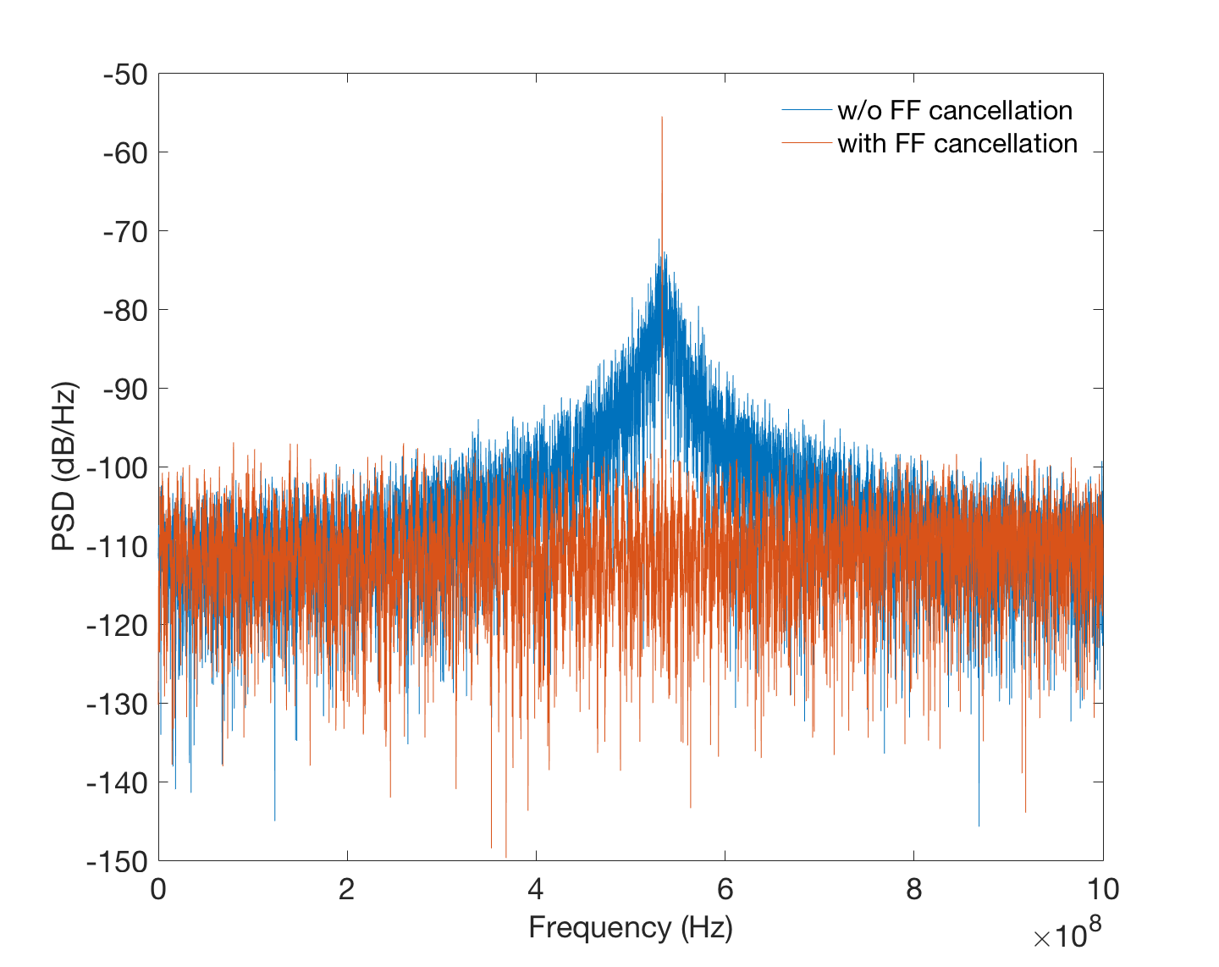
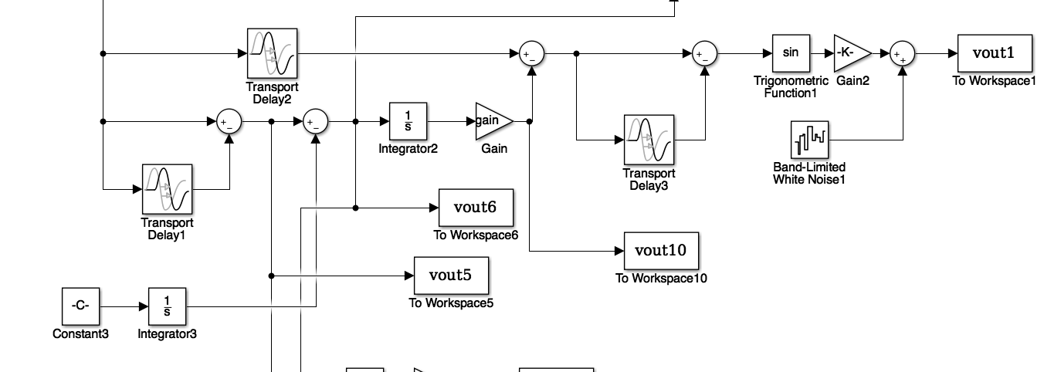
Simulation Result
Distance: 20m
Linewidth: 10MHz²/Hz
Scan time: 10us
Chirp bandwidth: 40GHz
MZI delay difference: 1ns

Slide 19
Implementation Issues
Gain/delay needs to be matched well
Gain of FF path ∝ 𝜏
On-chip 𝜏: a few ns at most
Requires huge gain…
Also, removal of phase ramp using analog mixer can introduce a lot of noise
Phase multiplication before downconverting could help
Phase
mod.
PD
Integrate
A
Final
laser out

Slide 20
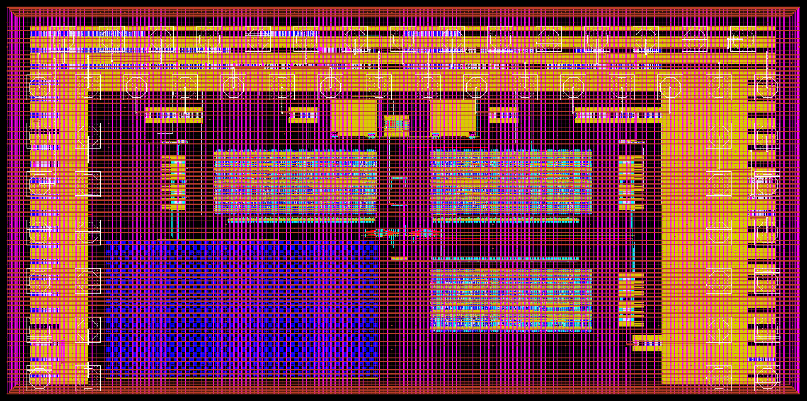
Actual Demonstration Platform
FMCW Lidar prototype chip CMOS: 3x1.5mm, GF45nm SOI process
Similar optical PLL system as Behnam’s but implemented in digital to have more flexibility so that it can be compatible with wider range of laser/photonics

Slide 21
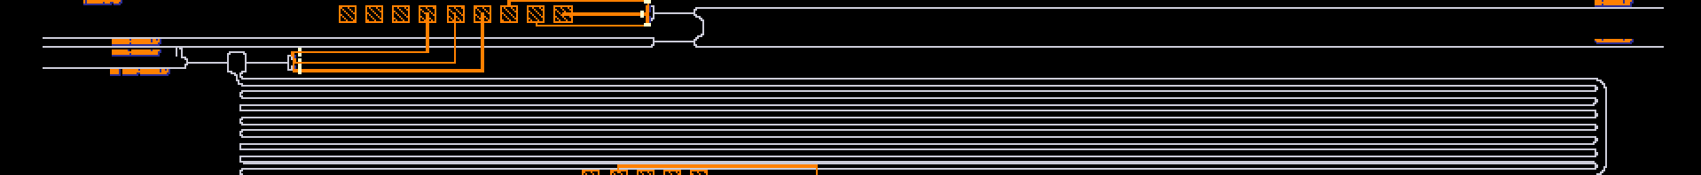
Actual Demonstration Platform
FMCW Lidar prototype chip photonics: CNSE 300mm process
BPD (got 20uApp for 0dBm)
Lidar TX/RX
LO Path
Delay (1.14ns)
9:1 tap

Slide 22
Conclusion

Slide 23
Digital OPLL Implementation
1.28GHz
8ps LSB
10MHz
128
7b
(couter)
7b
Signed 10b
10MHz
(fastest)
Sub-sampling to make this run at slower fb

Slide 24
Digital backend functionalities
Variable reference frequency operation
Feedback clock can be slower than nominal (10MHz) as we might want to use a laser with lower chirp rate or smaller chirping bandwidth
However, fine TDC resolution is set by inverter delay
By using frequency detector to introduce frequency offset, we can make the loop work with slower feedback frequency
Error values are updated only at the fb clock positive edge (sub-sampling operation)
All-pass triangular modulation by synchronized sign flipping

Slide 25
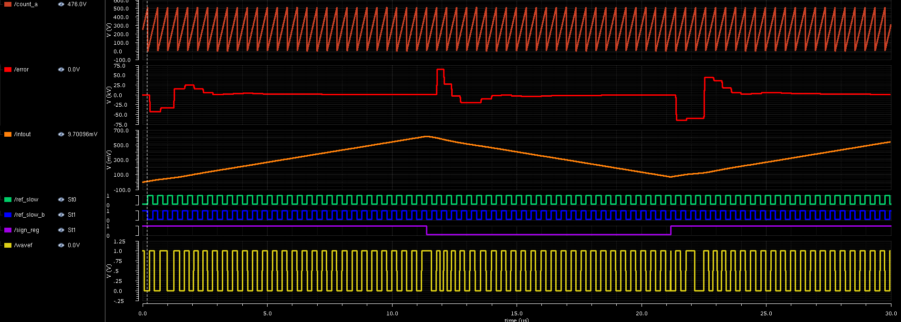
All-pass triangular modulation
When the sign is flipped, 𝜋 phase error is introduced instantaneously
(takes some time to settle, depending on loop BW)
Sign flipping – synchronized with ref. clk
Notes:
S_{t_{q,TDC}}(e^{j\omega T_R})=\frac{\left(\Delta t_{del}\right)^2}{12}

Slide 26

No Frequency Offset, Two Pt Mod On
By resetting the counter (coarse TDC) when the sign is flipped, we can cancel this 𝜋 phase error & hide sign flipping from the loop
Notes:
S_{t_{q,TDC}}(e^{j\omega T_R})=\frac{\left(\Delta t_{del}\right)^2}{12}

Slide 27
Noise Sources in Optical PLL
PIR control:
Proportional path : 𝛼
Integration path: 𝛽
Maximize laser noise suppression
Minimize additive noise from PLL
Minimize effective linewidth →
Notes:
S_{t_{q,TDC}}(e^{j\omega T_R})=\frac{\left(\Delta t_{del}\right)^2}{12}

Slide 28
Looking at the laser PSD, it is highpass → need to maximize loop bandwidth
Choose design variables accordingly so that additive noise is not exceeding laser phase noise
TDC LSB
LF gain
Current DAC LSB
Capacitance size
Buffer gain
Noise TF
Notes:
\frac{\phi_{out}}{\phi_{n,laser}}(s)=\frac{s^2}{s^2+\left( \frac{\tau}{2\pi} \frac{K_{laser}}{\Delta t_{del}} \frac{A_{drv}I_{LSB}}{C} \right) (\alpha s T_R + \beta)}=\frac{s^2}{s^2+\eta\alpha s T_R + \eta\beta} \frac{\phi_{out}}{t_{q,TDC}}(s)=\frac{1}{s}\frac{\frac{2\pi}{\tau}\eta (\alpha s T_R+\beta)}{s^2+\eta\alpha s T_R + \eta\beta}
S_{\phi_{out}}(f)|_{iDAC}=\frac{1}{T_R} \left| \frac{\phi_{out}}{t_{q,iDAC}}(f) \right|^2 S_{t_{q,iDAC}(e^{j\omega T_R})}
S_{\phi_{out}}(f)|_{laser}= \left| \frac{\phi_{out}}{\phi_{n,laser}}(f) \right|^2 S_{\phi_{n,laser}}(f) = 2\pi\Delta\nu \left| \frac{s}{s^2+s\frac{\omega_0}{Q} + \omega_0^2} \right|^2
S_{\phi_{out}}(f)|_{iDAC}=\frac{1}{T_R} \left| \frac{\phi_{out}}{t_{q,iDAC}}(f) \right|^2 S_{t_{q,iDAC}(e^{j\omega T_R})}=\frac{1}{12T_R} \left| \frac{\frac{2\pi}{\tau}\frac{\Delta t_{del}}{\alpha} \frac{\omega_0}{Q}}{s^2+s\frac{\omega_0}{Q} + \omega_0^2} \right|^2
S_{\phi_{out}}(f)|_{TDC}=\frac{1}{T_R} \left| \frac{\phi_{out}}{t_{q,TDC}}(f) \right|^2 S_{t_{q,TDC}(e^{j\omega T_R})}=\frac{(\Delta t_{del})^2}{12T_R} \left| \frac{1}{s} \frac{\frac{2\pi}{\tau} \eta T_R (s + \omega_z)}{s^2+ s\omega_0/Q + \omega_0^2} \right|^2

Slide 29
Design Procedure
Maximize the loop bandwidth while ensuring stability
The wider the bandwidth, the more the laser noise is suppressed
Set bandwidth to be 15% of the reference clock, Q=0.5
η and α/β determined
Now to choose α, I_{LSB}, C
Notes:
S_i(f) = \frac{{i_0}^2}{2}\left[ \frac{{\tau}_c/(2\pi)}{1+\left(\pi f {\tau}_c \right)^2} \left\{ 1- e^{-\frac{2\tau}{{\tau}_c}} \left[ \cos(2\pi f\tau) + \frac{1}{\pi f \tau_c} \sin(2\pi f \tau) \right] \right\} \right]
\tau_c = \frac{2}{\textrm{linewidth}},\quad i_0: \textrm{nominal photocurrent amplitude},\quad \tau: \textrm{path delay}

Slide 30
Design Procedure
Set α so that iDAC quantization noise is balanced with others
It fixes I_{LSB}/C ratio
Finally, increase I_{LSB} & C until iDAC thermal noise is balanced with others
Notes:
S_i(f) = \frac{{i_0}^2}{2}\left[ \frac{{\tau}_c/(2\pi)}{1+\left(\pi f {\tau}_c \right)^2} \left\{ 1- e^{-\frac{2\tau}{{\tau}_c}} \left[ \cos(2\pi f\tau) + \frac{1}{\pi f \tau_c} \sin(2\pi f \tau) \right] \right\} \right]
\tau_c = \frac{2}{\textrm{linewidth}},\quad i_0: \textrm{nominal photocurrent amplitude},\quad \tau: \textrm{path delay}

Slide 31
Plugging in Real Numbers
Given values:
Design parameters:
Runtime Parameters:

Slide 32
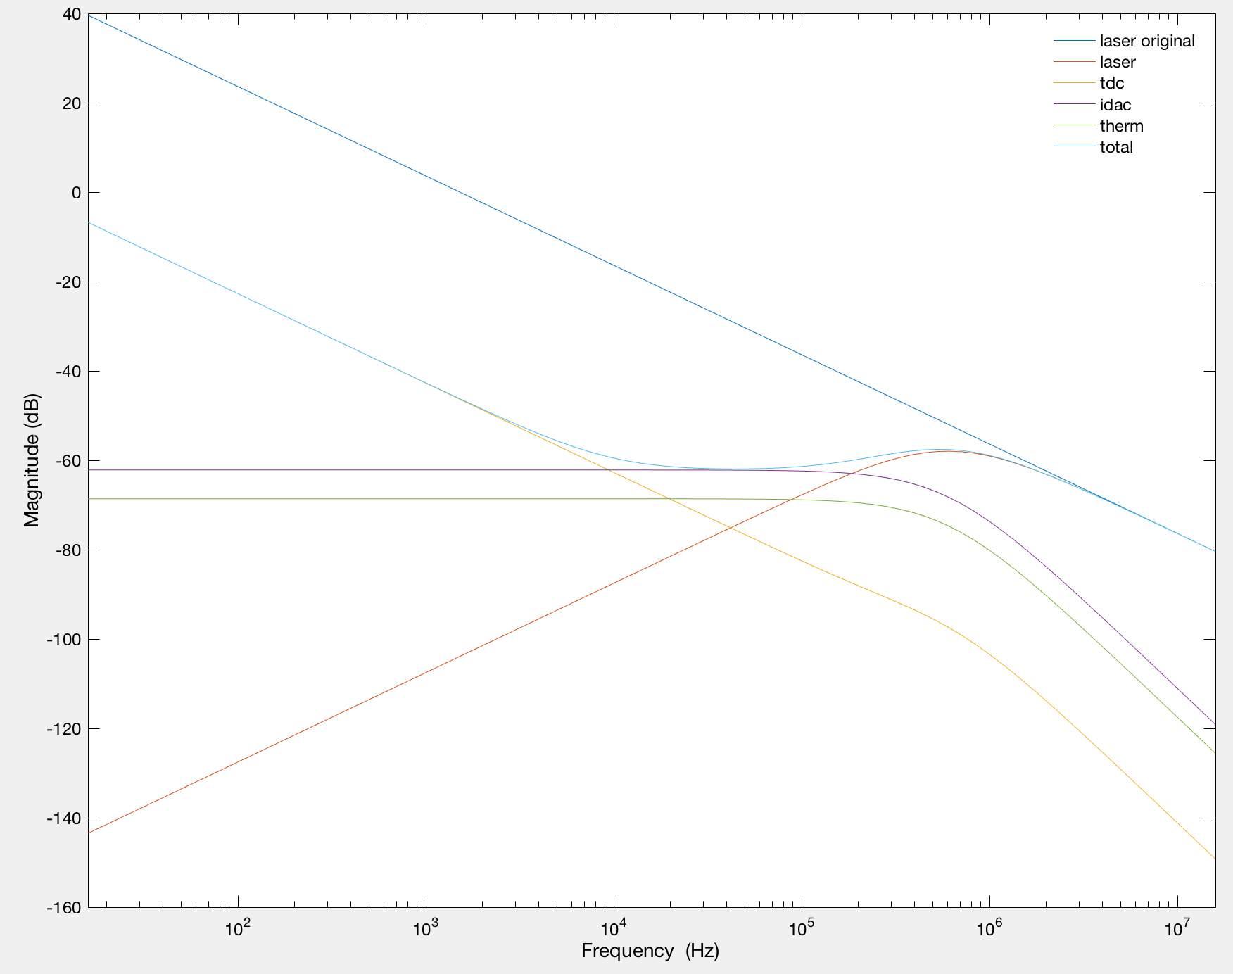
Plugging in Real Numbers

Slide 33
Optical PLL prototype chip (Aug.`17): 3x1.5mm

Slide 34
Optical PLL prototype chip (Aug.`17): 3x1.5mm
Variant 1
CML2CMOS
Variant 2
(variant 1 - capacitor)
Cur. Mir.
Variant 3
(variant 2 - laser buffer - TIA)

Slide 35
Photonics chip from EPHI (Mar.`15)
BPD (got 20uApp for 0dBm)
Lidar TX/RX
LO Path
Delay (1.14ns)
9:1 tap

Slide 36
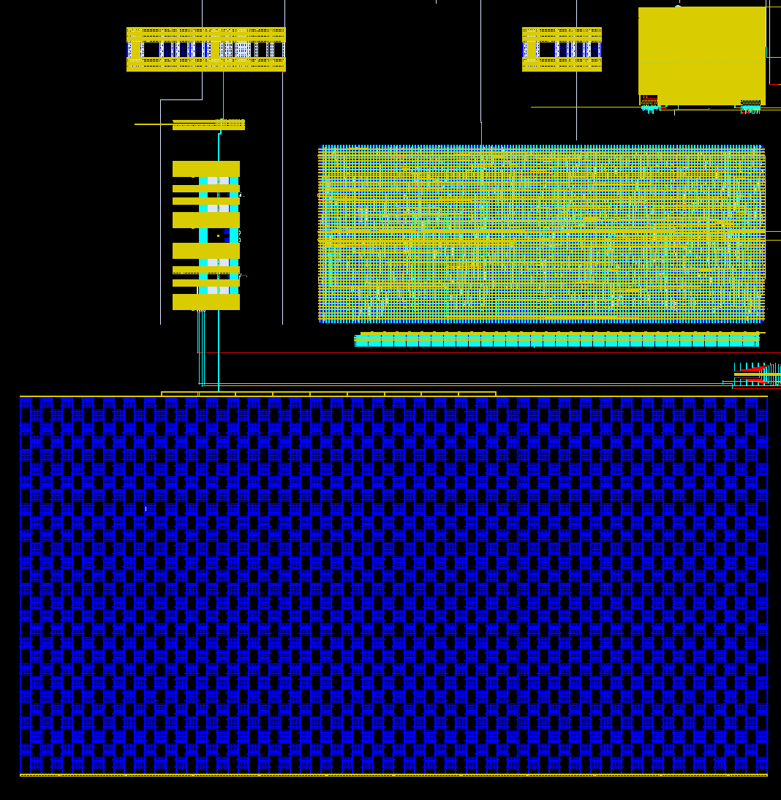
Optical PLL prototype chip (Aug.`17): 3x1.5mm
TIA
(DODOS)
Buffer
iDACs
Backend
Fine TDC chain
Capacitor

Slide 37
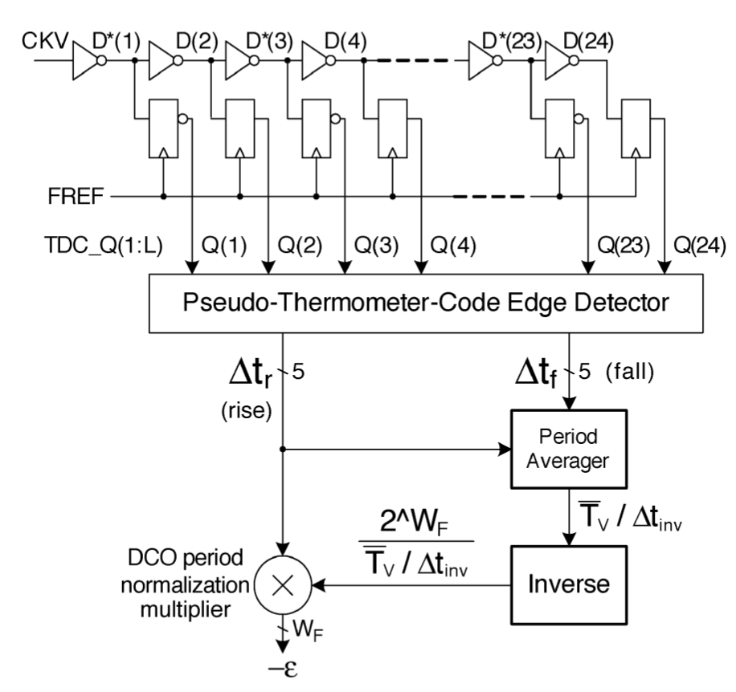
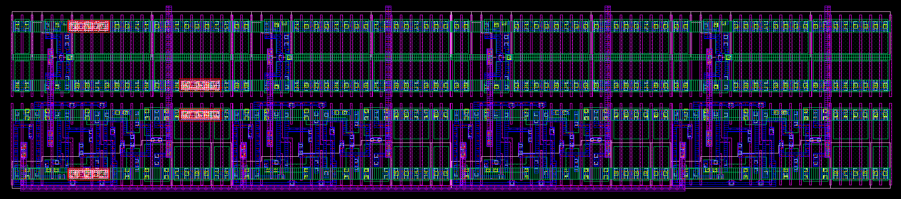
Fine TDC
Standard inverter-chain based TDC, 8ps LSB @ 1V
128 segments -> 7bit
Capable of calibrating the normalization factor by measuring fast clock period in # of inverter delays (nominal: ~100)
Clock tree to minimize the skew
[Staszewski 2004]
Clock tree

Slide 38
Sign generator for triangular waveform
(From pad)
(From pad)

Slide 39
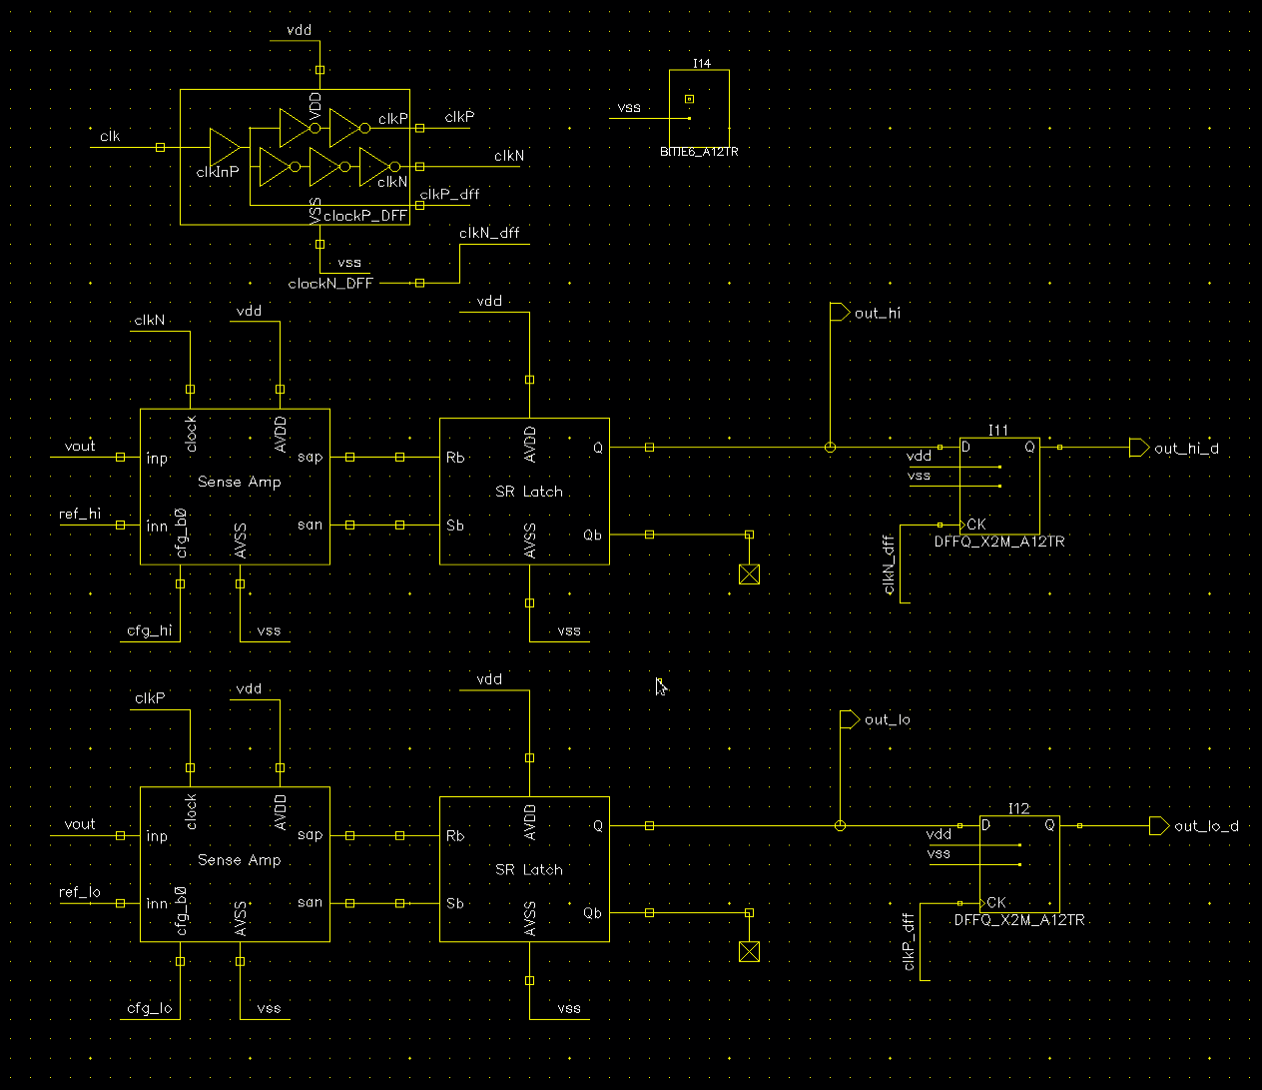
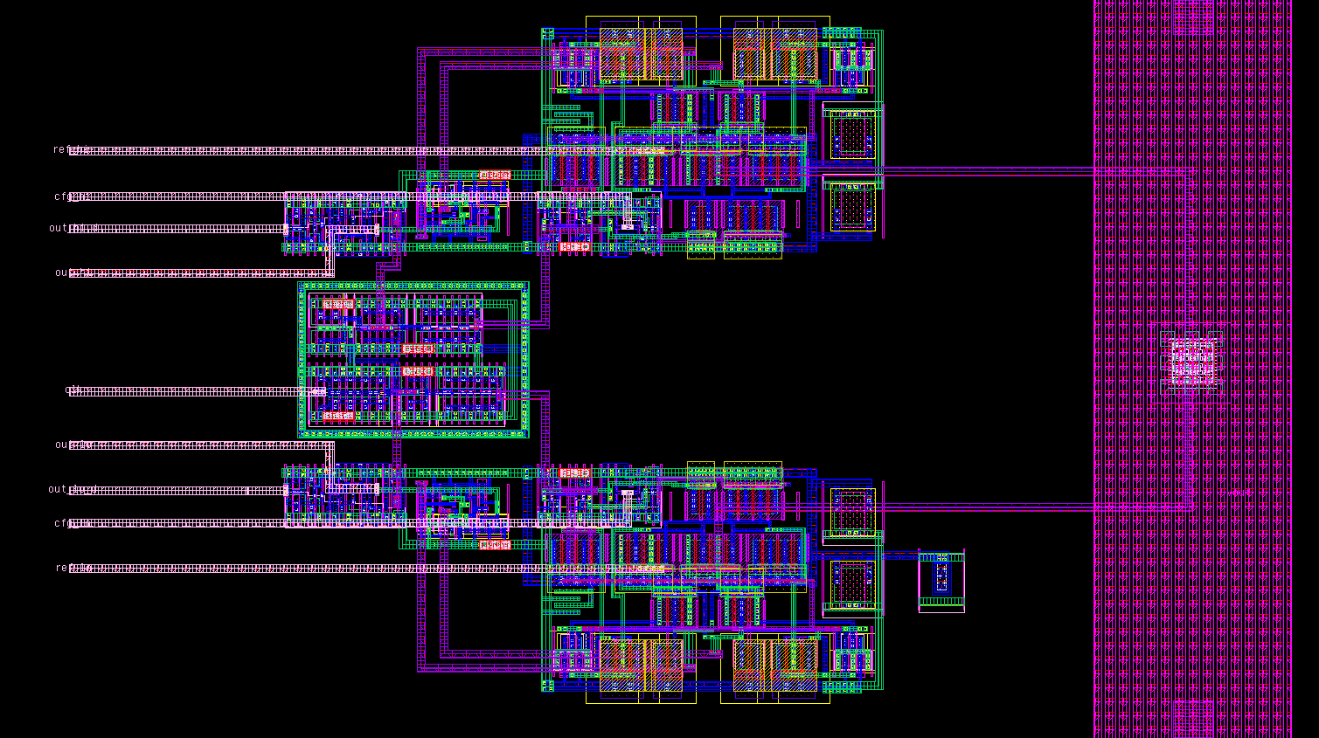
Sign generator for triangular waveform
In digital backend
(From pad)
(From pad)
Nandish’s StrongArm design reused

Slide 40
Current DAC & capacitance
Push-pull DAC (9b)
Desiged LSB 100nA
Pulse width of sign & sign_b are slightly reduced to make sure it’s either sinking or sourcing (not both)
Reference current of sink/source DAC can be independently controlled by central current mirror (can correct current mismatch off-chip)
Cap: dgncap (3.8x4.8u*2016) ~ 3.6nF @ 0.9V
9b
9b
9b
9b

Slide 41
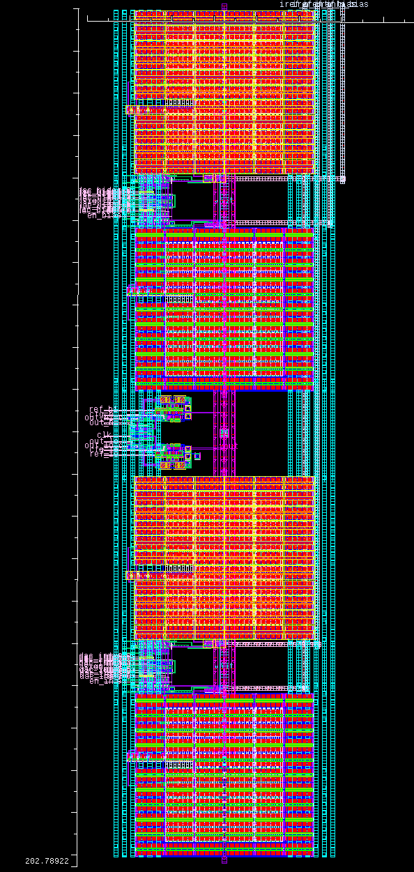
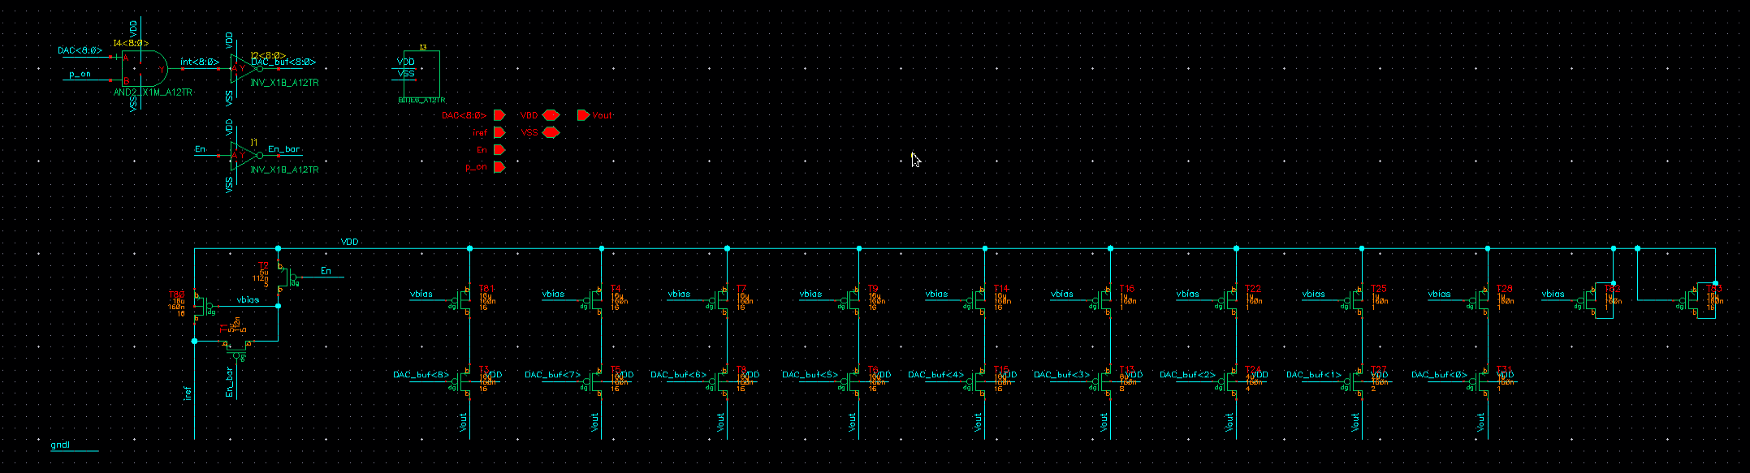
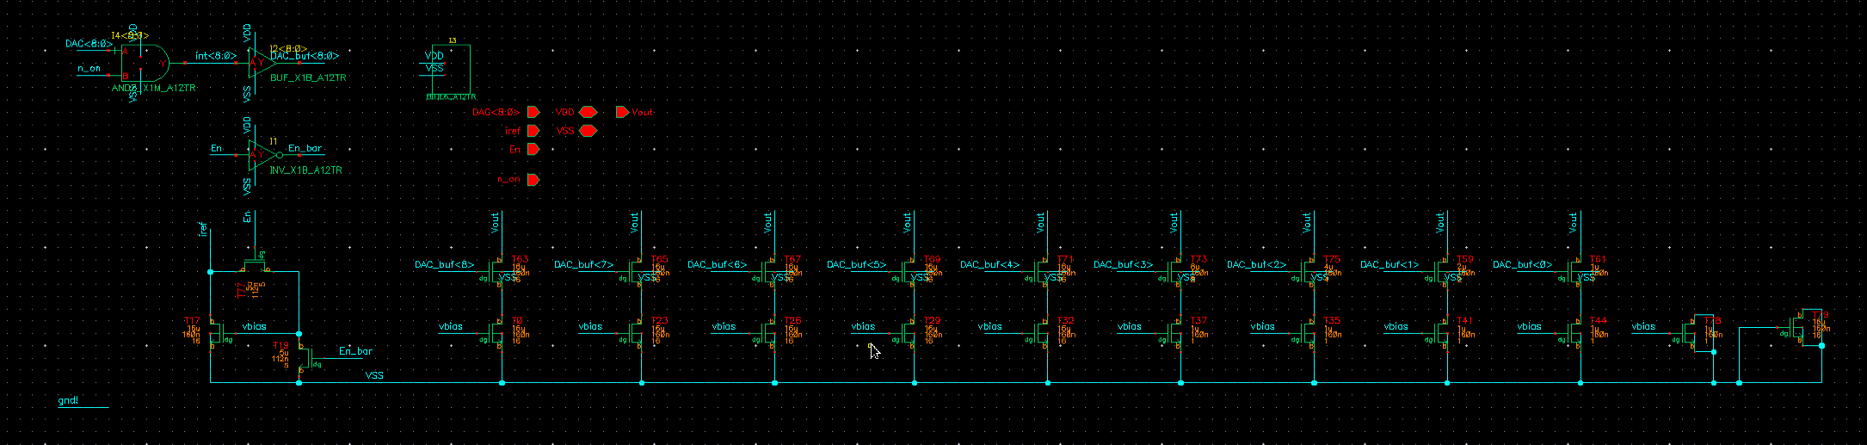
Current DAC
Based on Pavan’s current mirror design

Slide 42
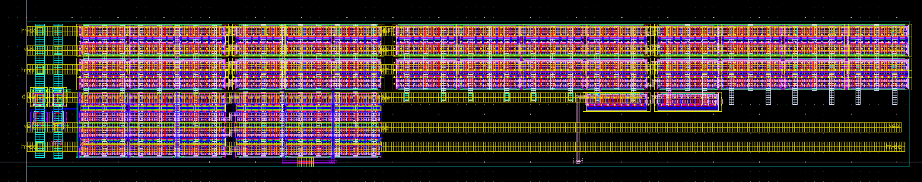
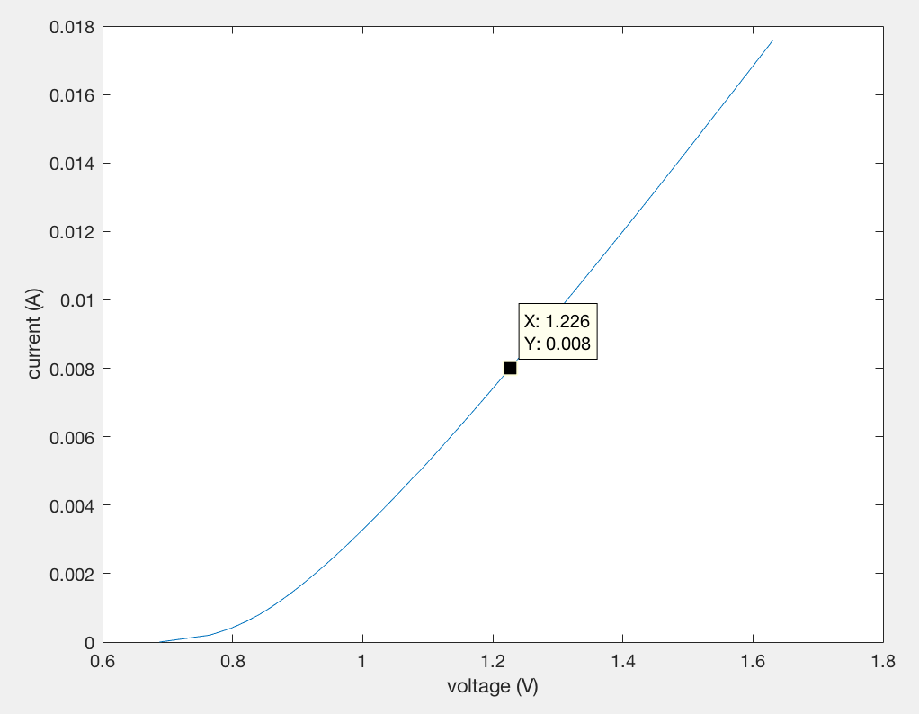
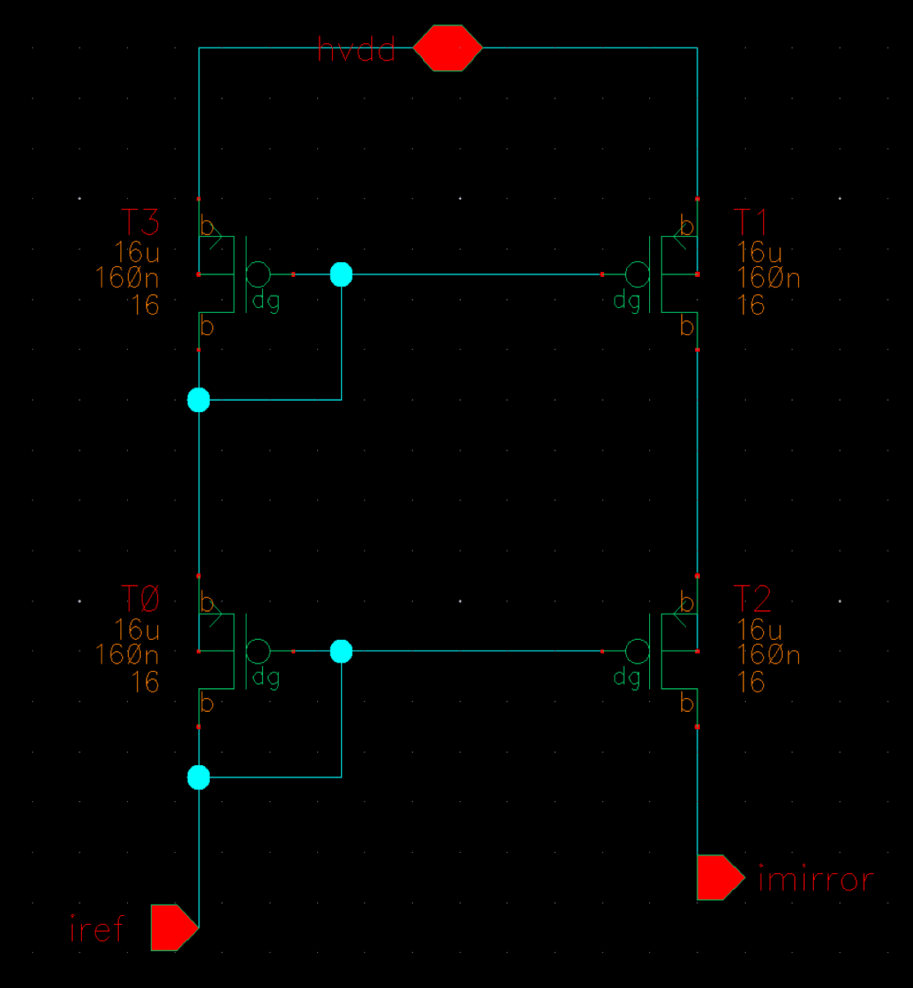
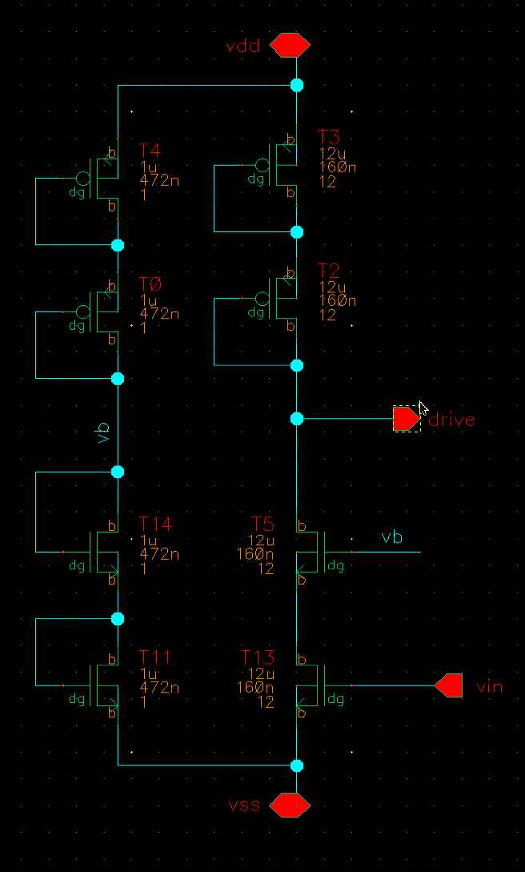
Laser buffer
Laser tuning input V/I curve
Desired bias point
(8mA, 1.27V)
Roughly modeled as diode + 50Ohms in series
Dedicated current reference for biasing at 8mA
For 100GHz chirp BW, ~3mApp swing required
Designed transconductance: 20mS

